Slide 1
Python Mini-Project FY EXCP Sem II ( 2022-23) Batch P1-2
Title: Automated email sending by reading from excel data
16014022050, 16014022058, 16014022064

Slide 2
Problem Statement
The objective of this program is to automate the process of sending emails to a list of recipients stored in an Excel file. The program reads the recipient details from the Excel file, including email addresses, names, and marks. It then validates the email addresses, sends personalized email notifications with the marks, and updates the status of each email in the Excel file.

Slide 3
System Architecture
The code provides information about various aspects of the Student’s data, such as attendance, marks etc.
The program reads the data from an Excel sheet, extracting information such as recipient names, email addresses, attendance, marks any other necessary fields required for personalization.
We have used the if function, Pandas to store the data into a database and some other libraries like tkinter, smtplib, etc. and also used GUI to provide a better experience to the user while filling the data.
We also used try-except and the finally block file handlings.

Slide 4
System Architecture (Algorithm)
Reading data and authenticating email/password from SMTP server
Define a function named send_emails to handle the email sending process.
Retrieve the sender's email and password from environment variables.
Check if the sender's password is set in the environment variable. If not, display an error message and return.
Get the path of the Excel file and sheet name from the GUI input field.
Use pd.ExcelFile and pd.read_excel to open and read the Excel file, storing the data in a DataFrame.
Extract the email addresses, names, and marks from the DataFrame and store them in separate lists.
Set the SMTP server and port for sending emails using Gmail's SMTP server.
Define a regular expression pattern to validate email addresses.
Establish a connection with the SMTP server and enable encryption for a secure connection.
Authenticate the sender's email and password with the SMTP server.

Slide 5
System Architecture (Algorithm)
Getting data (email & marks), writing message, updating new file
Iterate over the email, name, and mark lists using zip.
If the email address is "-1", add "Invalid Email" to the status list and break the loop.
Create the subject and body of the email based on the recipient's name and mark.
Use smtp_connection.sendmail to send the email to the recipient.
Log a success message and add "Sent" to the status list.
If an SMTP exception occurs, log an error message, add "Unsent" to the status list, and attempt to retry sending the email twice with a 10-second delay.
Add the status list as a new column named "Status" in the DataFrame.
Specify the path for the updated Excel file and save the DataFrame to the file.
Log a message indicating that the email status has been updated and saved.
Filter the DataFrame to extract rows with "Invalid Email" or "Unsent" status.

Slide 6
System Architecture (Algorithm)
Creating GUI environment
Define a function named browse_file to handle browsing and selecting the Excel file using the file dialog.
Use filedialog.askopenfilename to display the file dialog and get the selected filename and update the Excel file entry field
Create the main GUI window using tkinter.Tk() and set the title of the GUI window.
Create GUI components: labels, entry fields, and buttons.
Define the layout of the GUI using the grid method.
Assign functions to the button click events.
Run the GUI main event loop using root.mainloop().

Slide 7
Features of Designed System
The program provides a user-friendly graphical interface where the user can browse and select the input Excel file. Additionally, the user can specify the sheet name containing the recipient data. After selecting the file and sheet, the user can initiate the email sending process.
During the email sending process, the program can handle scenarios such as invalid email addresses or failed email deliveries. It provides appropriate error messages and retry mechanisms to ensure successful delivery of emails. The program also update the status of each email in the Excel file, indicating whether the email was sent successfully or encountered an error.
The program can save the updated Excel file with the email status information. It creates a separate Excel file containing the details of emails that were marked as invalid email addresses or unsent.

Slide 8
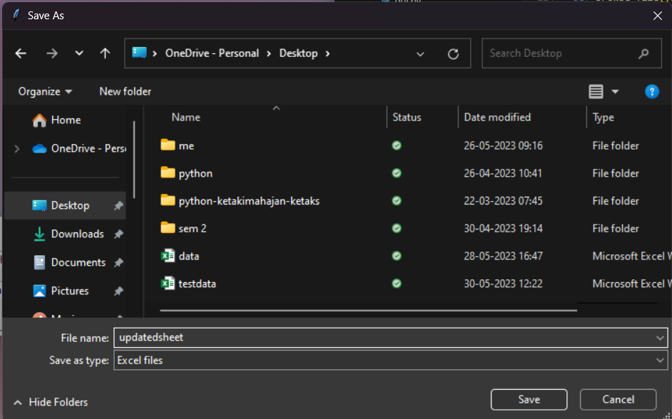
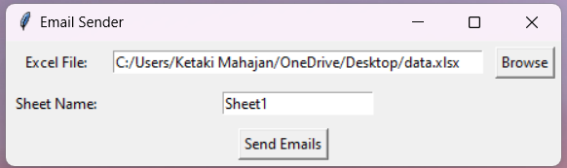
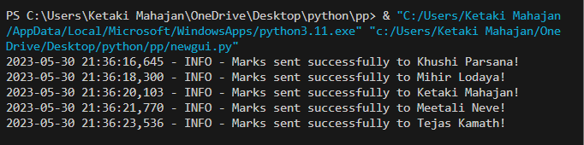
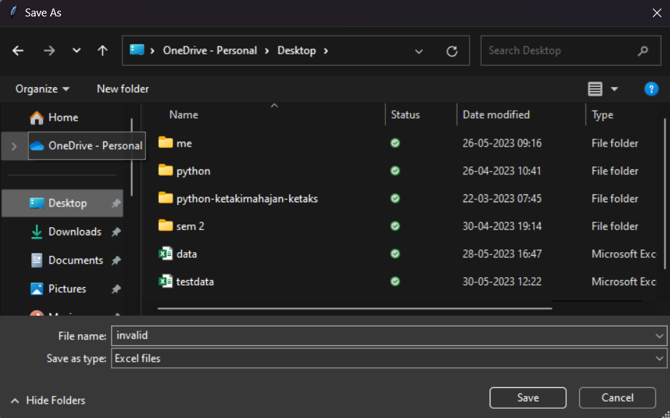
Results
3. Dialog asking to save the new excel files, updated list containing status of all mail and invalid list containing status = ‘invalid email’ or ‘unsent’
1. Upon running the file a dialog box asks the file and sheet name
2. Output displaying status of mails (successfully sent)

Slide 9
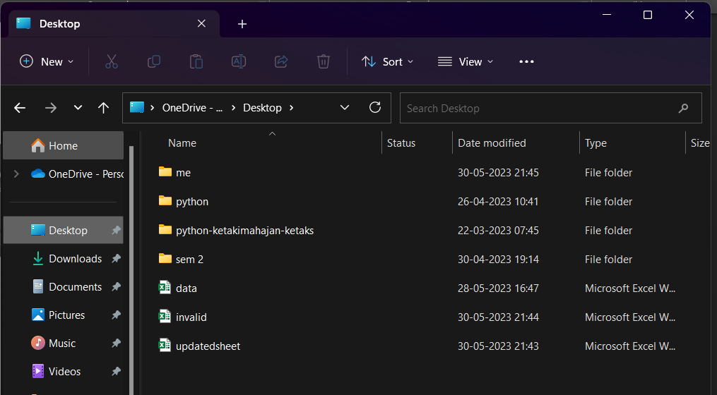
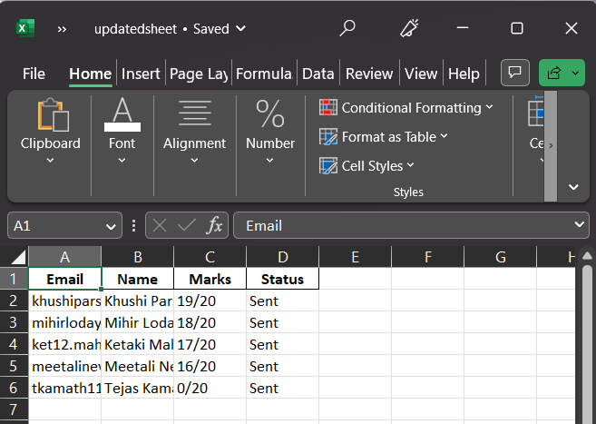
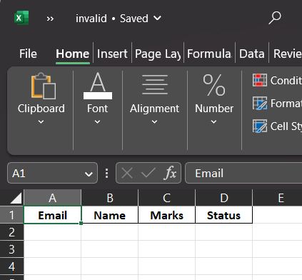
Results
4. Both files saved

Slide 10
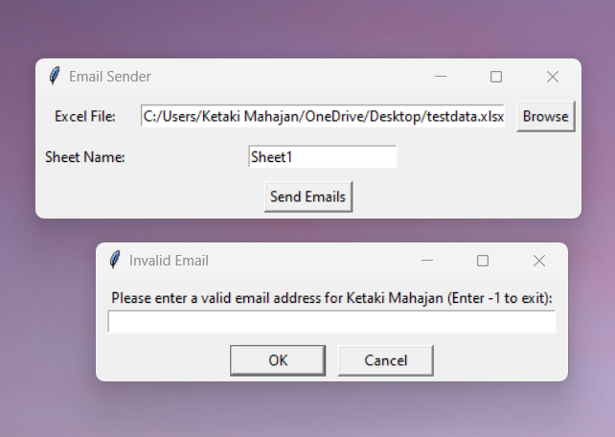
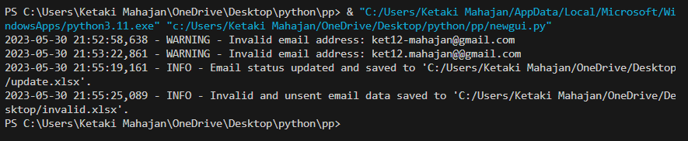
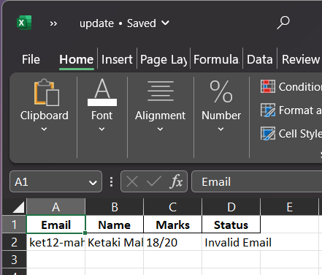
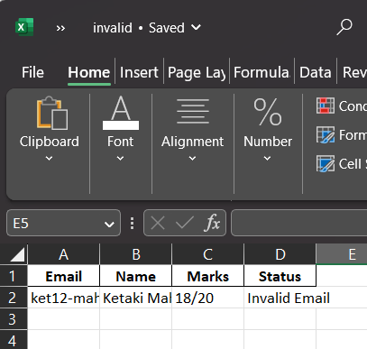
Results
In case of errors (invalid mail):
2. Output displaying status of mails
1. Invalid email opens another dialog box to enter current mail
3. New excel sheets created

Slide 11
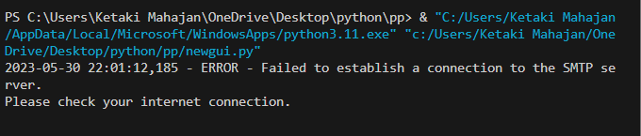
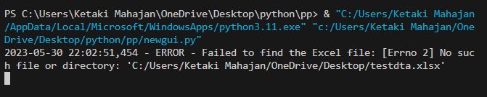
Results
In case of errors (internet connection):
In case of errors (Unable to find file):

Slide 12
Conclusion
The Python mini-project provided us with an excellent opportunity to apply the skills we acquired throughout the semester to real-life projects. It allowed us to utilize concepts like try/except blocks, function creation, and conditional and iterative constructs such as if and for loops. Additionally, the project enabled us to explore and gain familiarity with various libraries such as tkinter for GUI development, smtp for email sending, and navigate through a complex program structure.
Overall, this project enriched our practical understanding of Python programming and expanded our knowledge of different libraries and their functionalities.

Slide 13
Thank You!

